Slide 1
Subject-Web Application Development
Class-1
[Introducing React]

Slide 2
Content
Old-School Multipage Design
New-School Single-Page Apps
Meet React
Automatic UI State Management
Lightning-Fast DOM Manipulation
APIs to Create Truly Composable UIs
Visuals Defined Entirely in JavaScript
Just the V in an MVC Architecture
Conclusion

Slide 3
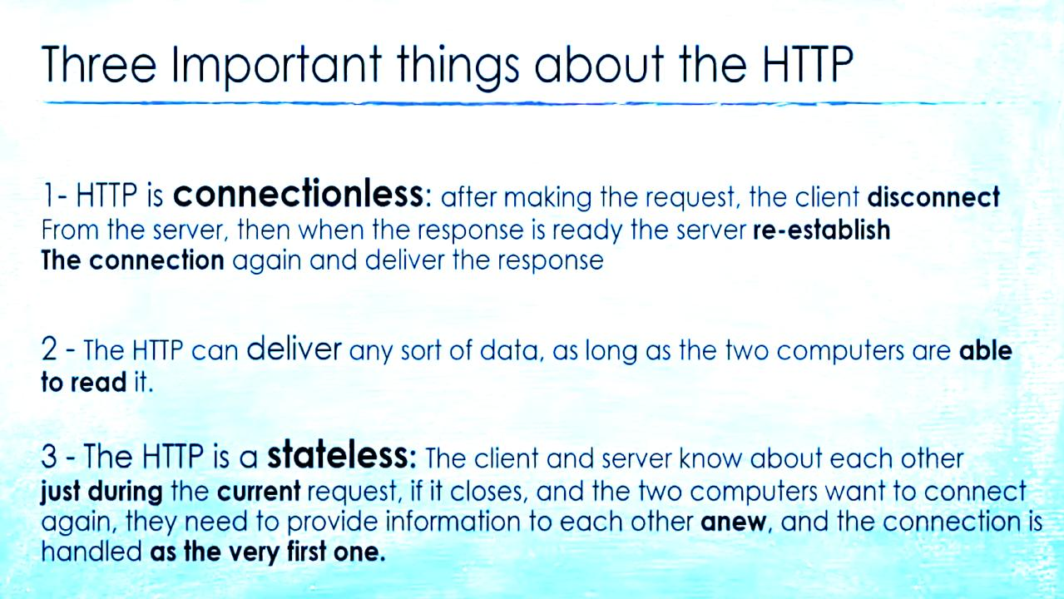

Slide 4


Slide 5
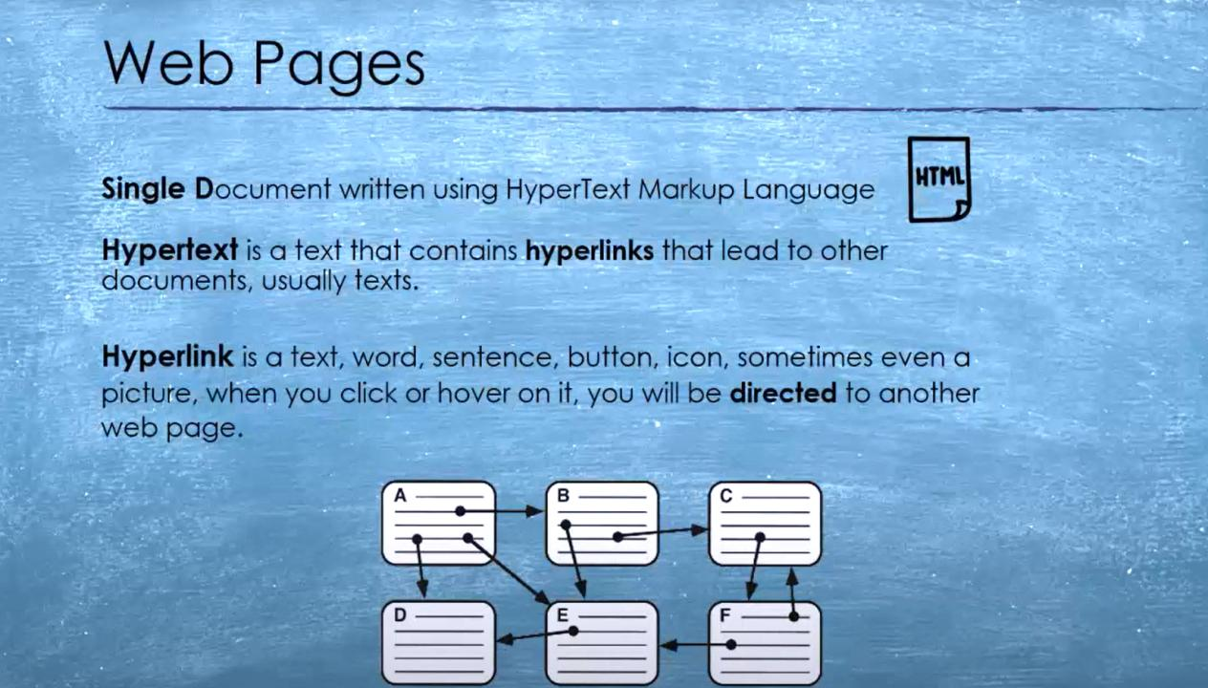

Slide 6


Slide 7


Slide 8


Slide 9
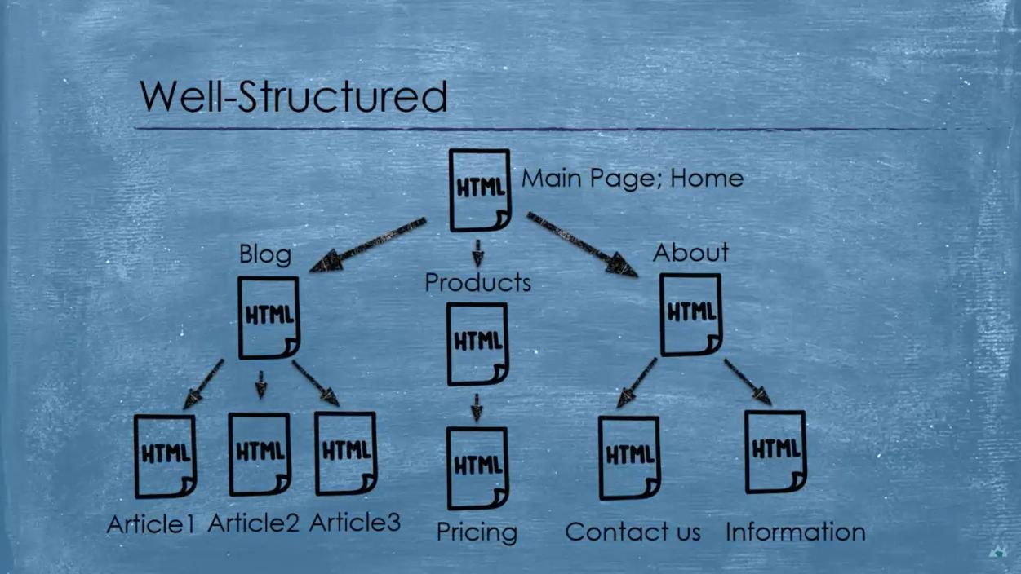

Slide 10
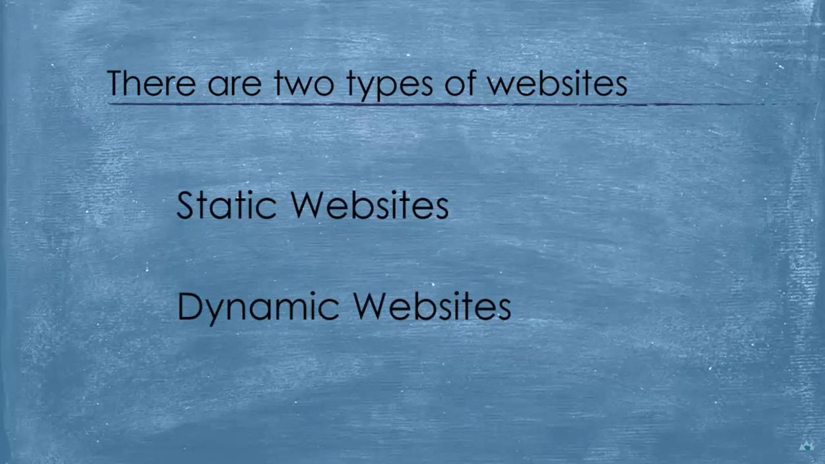

Slide 11
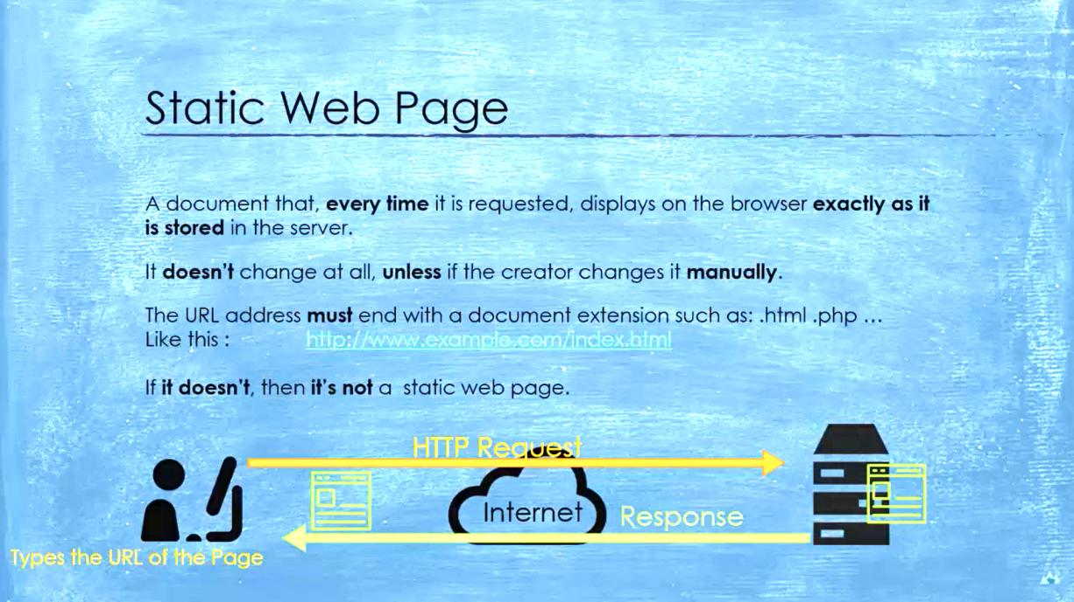

Slide 12
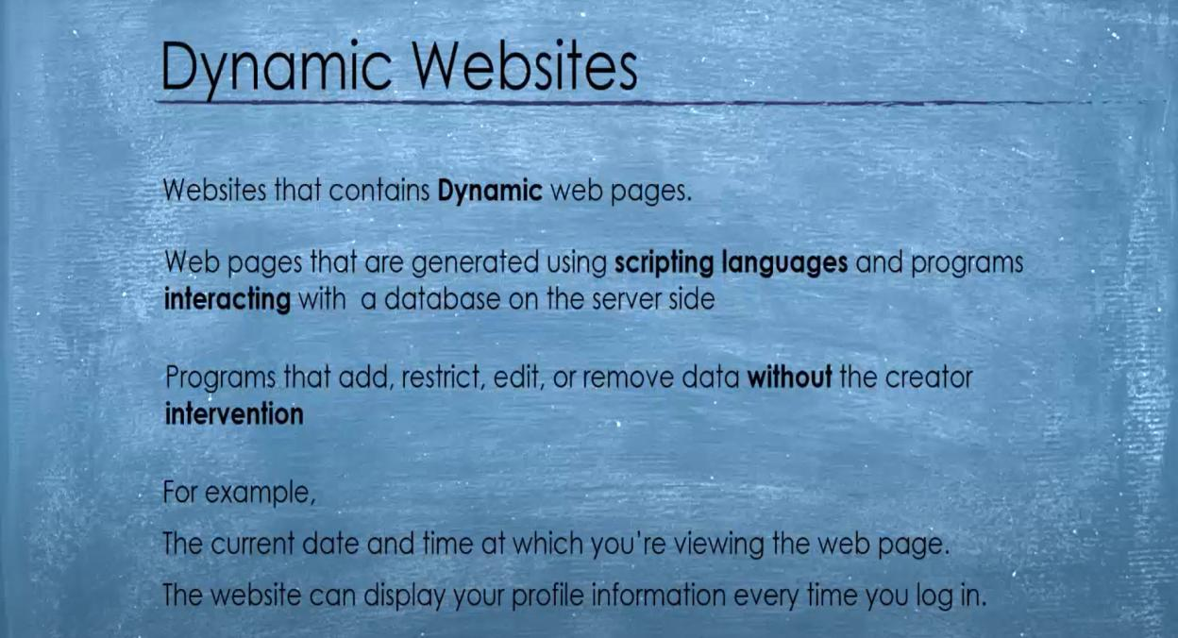

Slide 13
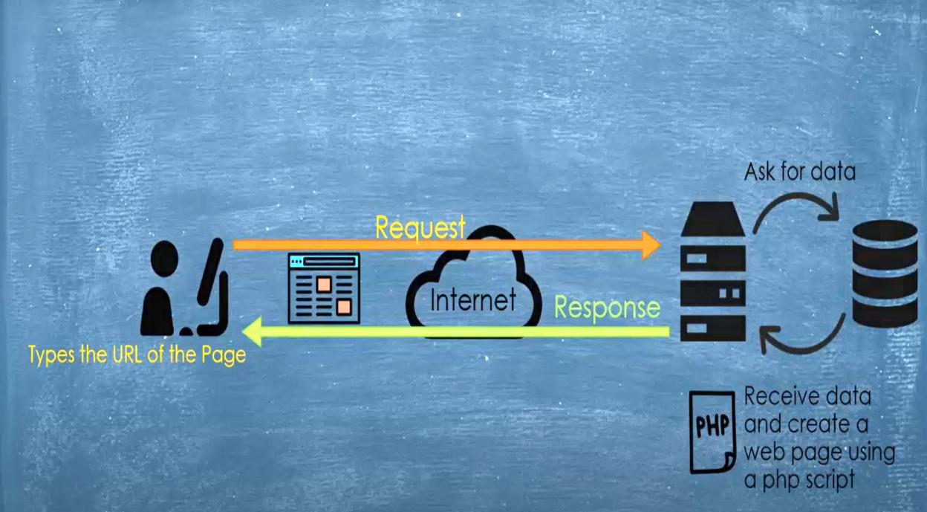

Slide 14
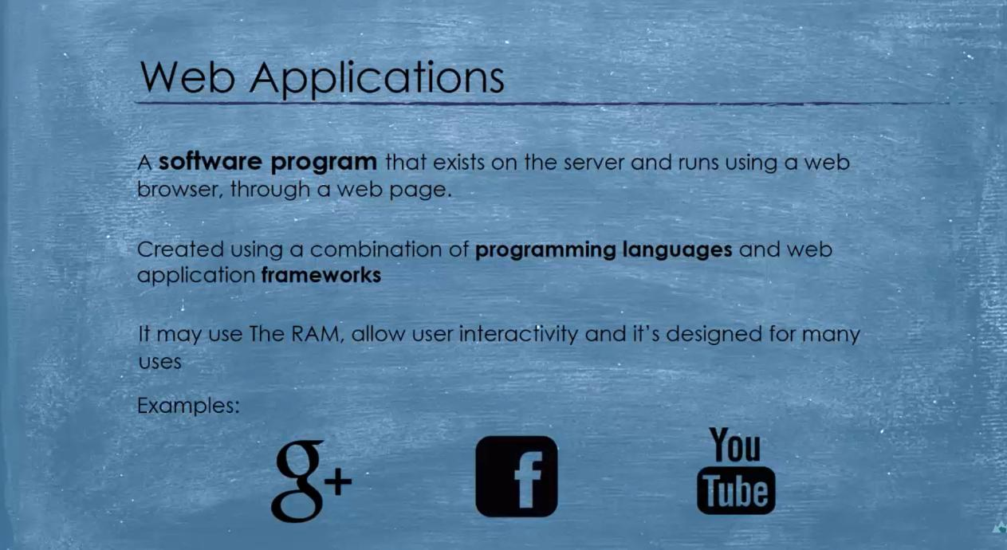

Slide 15
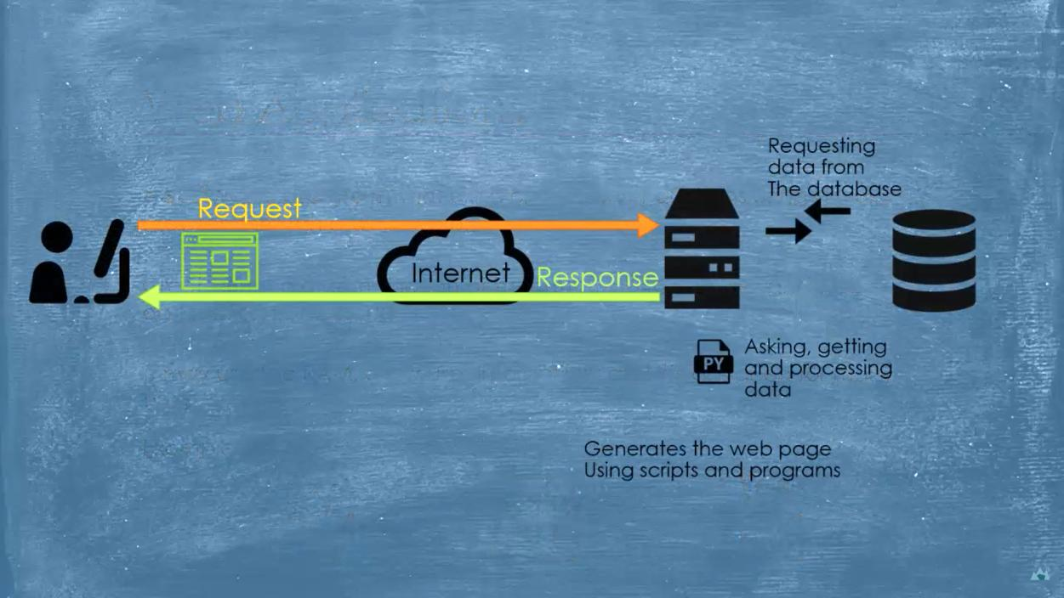

Slide 16


Slide 17


Slide 18
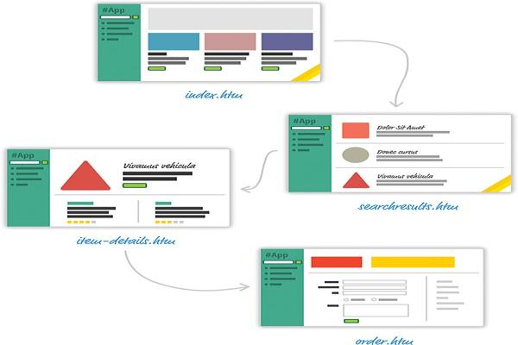
Old-School Multipage Design
For almost every action that changes what the browser displays, the web app navigates you to a whole different
page. This is a big deal, beyond just the less-than-stellar user experience users will see as pages get torn down and redrawn.

Slide 19
New-School Single-Page Apps
These days, going with a web app model that requires navigating between individual pages seems dated—really dated.
Instead, modern apps tend to adhere to what is known as a single-page app (SPA) model.
This model gives you a world in which you never navigate to different pages or ever even reload a page.
In this world, the different views of your app are loaded and unloaded into the same page itself.
If you’ve ever used popular web apps like Gmail, Facebook, Instagram, or Twitter, you’ve used a single-page app.
In all those apps, the content gets dynamically displayed without requiring you to refresh or navigate to a different page.
When building single-page apps, you’ll encounter three major issues at some point:
1. In a single-page application, you’ll spend the bulk of your time keeping your data in sync with your UI.
2. Manipulating the DOM is really, really slow.
3. Working with HTML templates can be a pain.

Slide 20

Meet React
Facebook (and Instagram) decided that enough is enough. Given their huge experience with single-page apps, they released a library called React to not only address these shortcomings, but also change how we think about building single-page apps.
The big things React brings :
Automatic UI State Management-
Lightning-Fast DOM Manipulation
APIs to Create Truly Composable Uis
Visuals Defined Entirely in JavaScript
Just the V in an MVC Architecture

Slide 21
Meet React Automatic UI State Management
With single-page apps, keeping track of your UI and maintaining state is hard … and also very time consuming.
With React, you need to worry about only one thing: the final state of your UI.
It doesn’t matter what state your UI started out in.
It doesn’t matter what series of steps your users took to change the UI.
All that matters is where your UI ended up React takes care of everything else.

Slide 22
Meet React Lightning-Fast DOM Manipulation
Because DOM modifications are really slow, you never modify the DOM directly using React.
Instead, you modify an in-memory virtual DOM Manipulating this virtual DOM is extremely fast, and React takes care of updating the real DOM when the time is right.
It does so by comparing the changes between your virtual DOM and the real DOM, figuring out which changes actually matter, and
making the fewest number of DOM changes needed to keep everything up-to-date in a process called reconciliation.

Slide 23

The HTML DOM Tree of Objects

Slide 24
Meet React APIs to Create Truly Composable Uis
Instead of treating the visual elements in your app as one monolithic chunk, React encourages you to break your visual elements into smaller and smaller components .
Many of React’s core APIs revolve around making it easier to create smaller visual components that can later be composed with other visual components to make larger and more complex visual components

Slide 25
Meet React Visuals Defined Entirely in JavaScript
With React, By having your UI defined entirely in JavaScript, you get to use all the rich functionality JavaScript provides for doing all sorts of things inside your templates.

Slide 26
Meet React Just the V in an MVC Architecture
React works primarily in the View layer, where all of its worries and concerns revolve around keeping your visual elements up-to-date.
This means you’re free to use whatever you want for the M and C parts of your MVC (a.k.a. Model-View-Controller) architecture.

Slide 27
Conclusion
As new web frameworks and libraries go, React is a runaway success.
It not only deals with the most common problems developers face when building single-page apps, but it also throws in a few additional tricks that make building the visuals for your single-page apps much easier.
Since it came out in 2013, React has also steadily found its way into popular web sites and apps that you probably use.
Besides Facebook and Instagram, some notable ones include the BBC, Khan Academy, PayPal, Reddit, The New York Times, and Yahoo!, among many others.

Slide 28
Thank You

